Slide 1


Topological Offsets
Daniel Zint, Zhouyuan Chen, Yifei Zhu, Denis Zorin,
Teseo Schneider, Daniele Panozzo

Slide 2
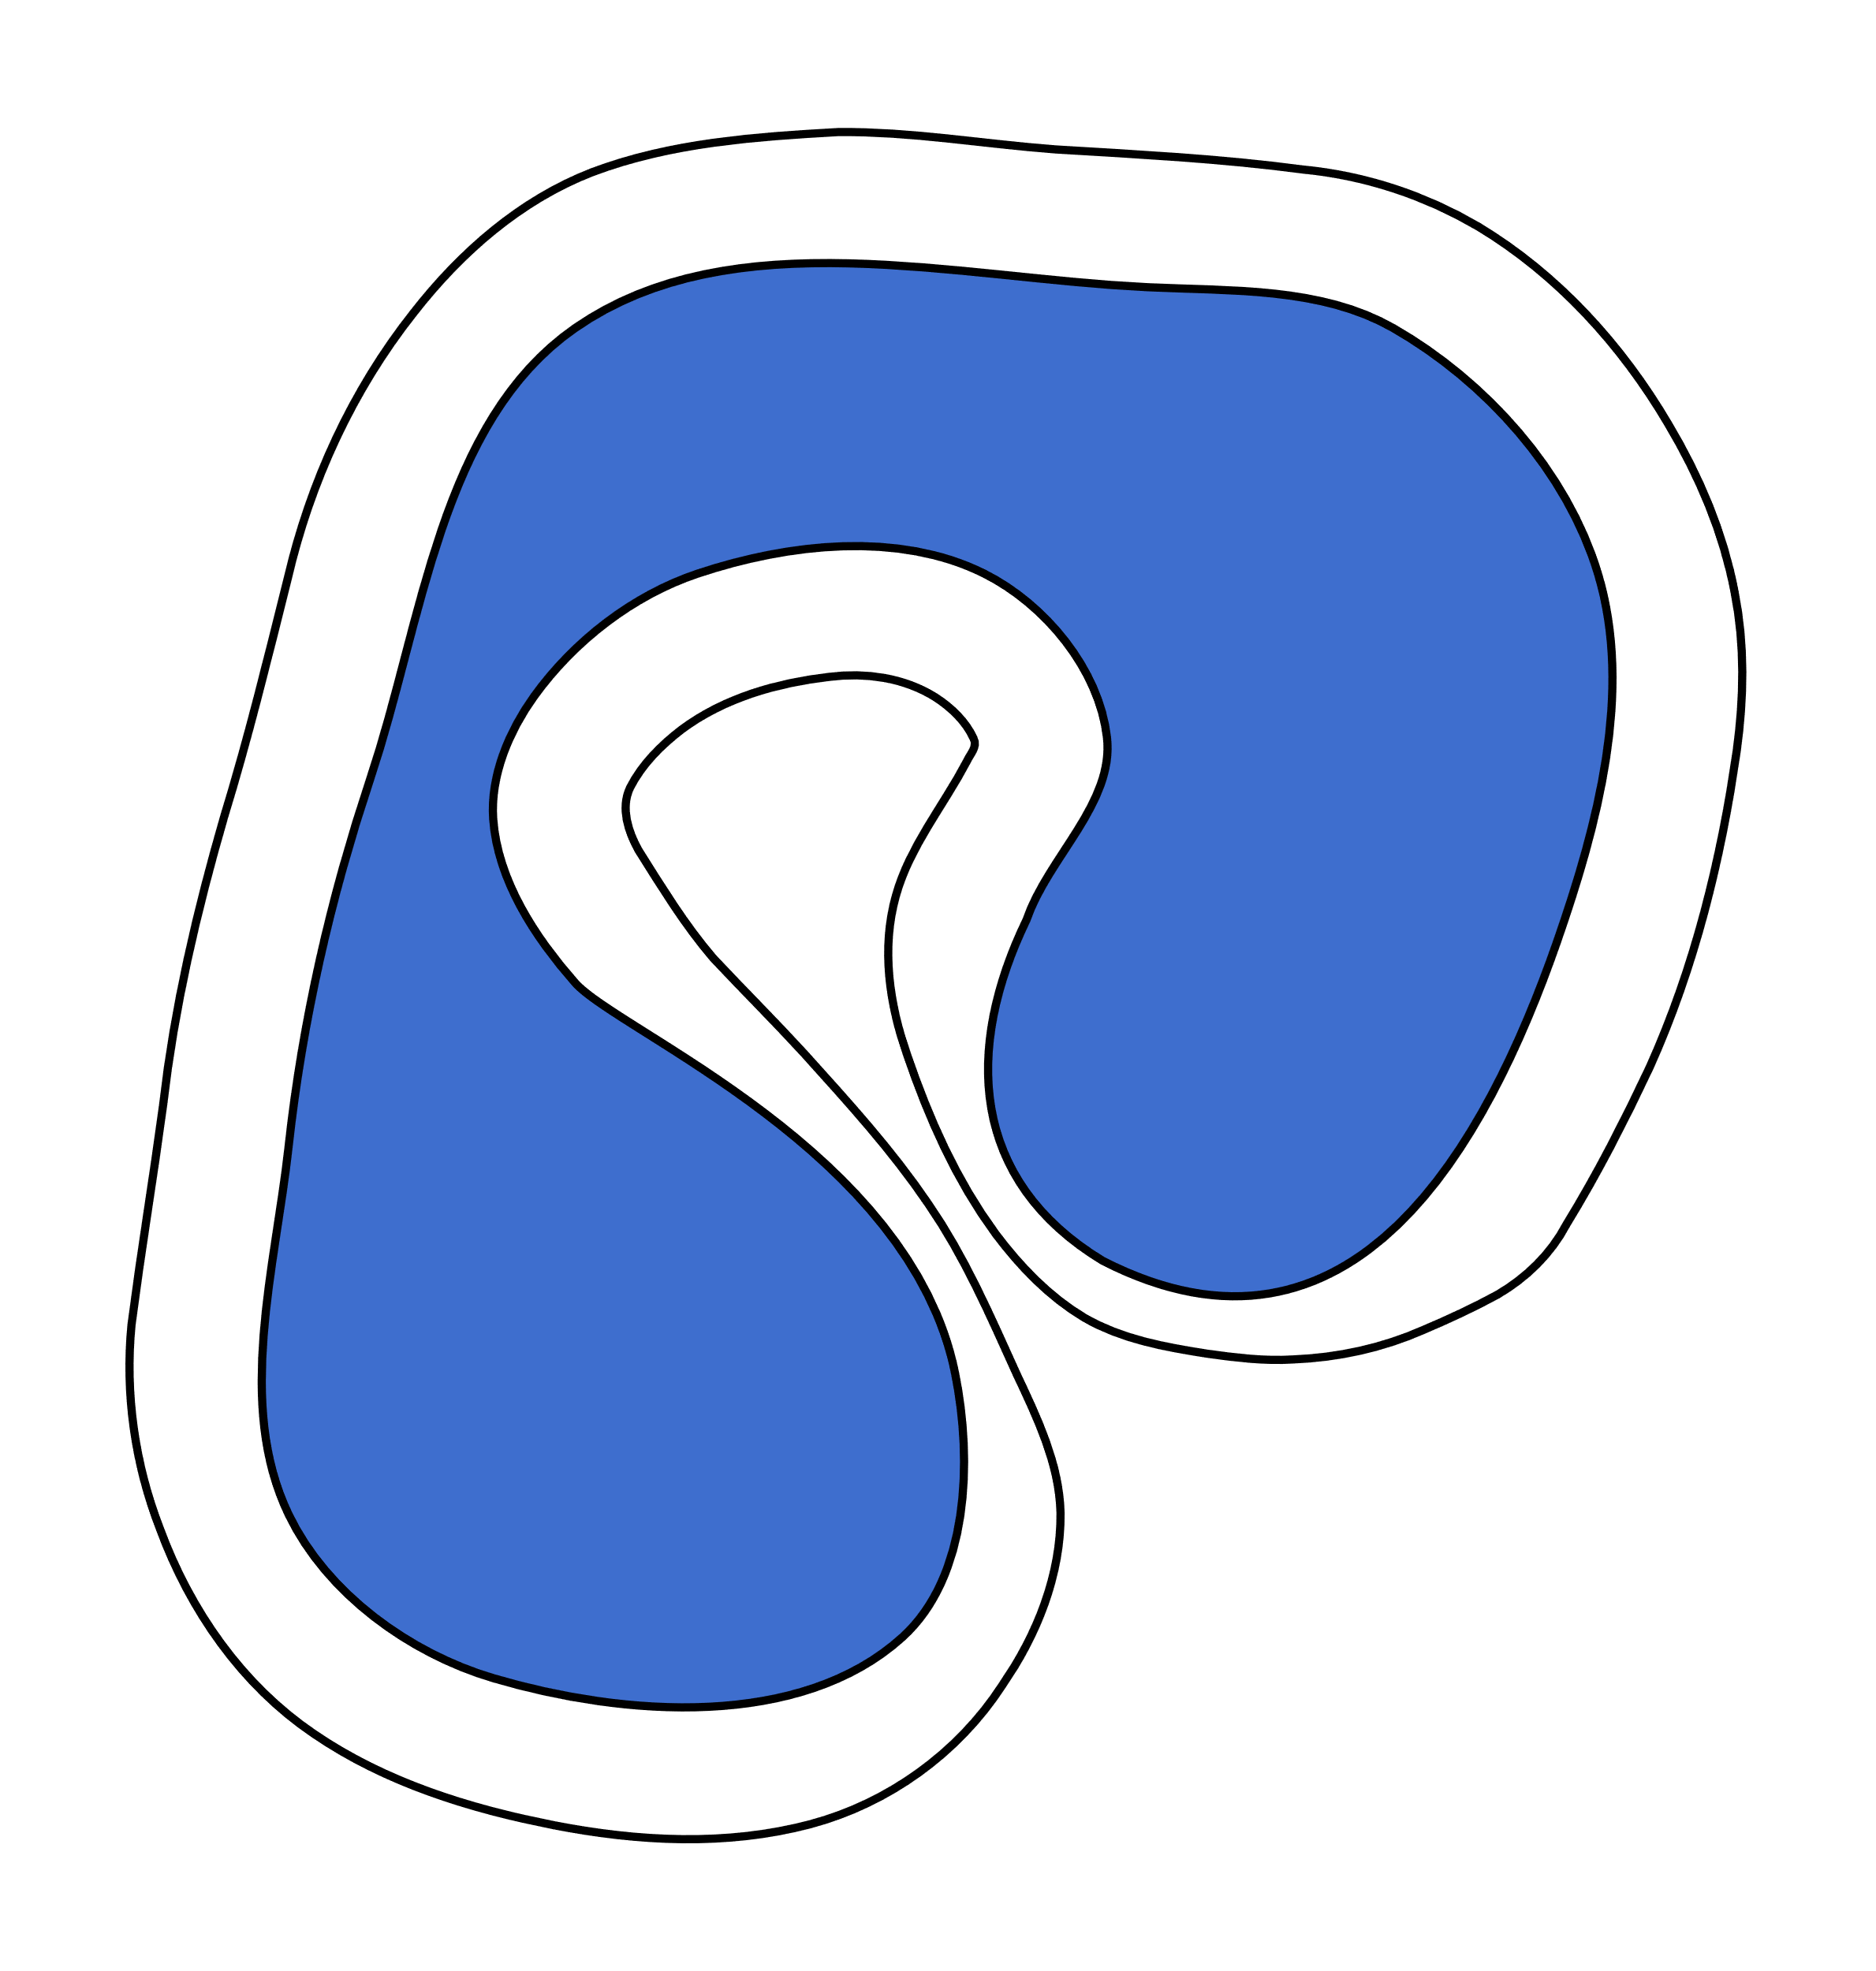
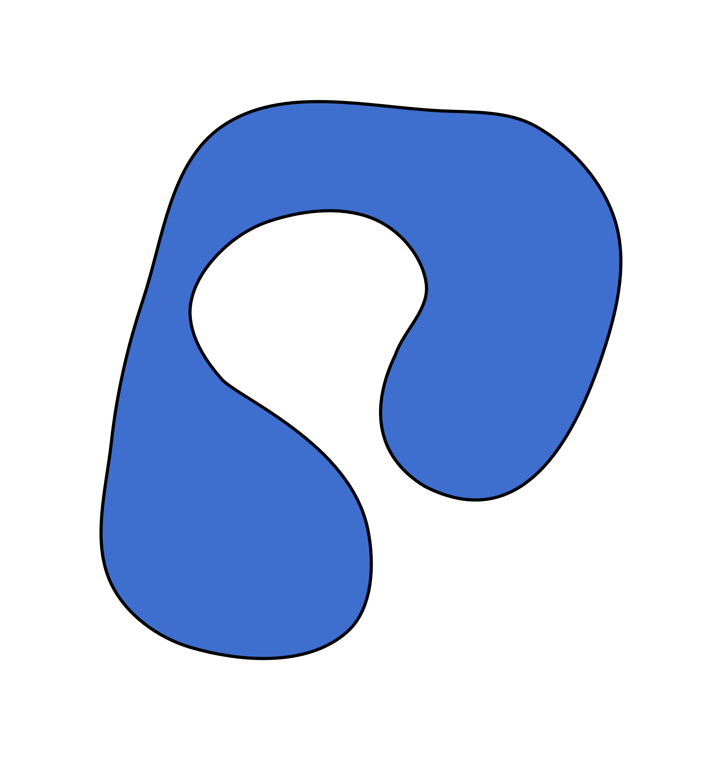


Topological Offsets
topological offset
input
finite offset
guaranteed topology
Notes:
When you construct an offset around an object like this one, its topology is usually unknown because it depends on the offset distance.
Here, for example, the offset will close this gap when choosing a larger offset distance.
This behavior is desired in many applications, like morphological operations, that you can use to clean up noisy input data.
However, in many applications, you do not want to close the gap, and therefore, we developed topological offsets that are guaranteed to have the topology of an infinitesimal offset.
But of course, this comes at a price; the offset distance then cannot be the target distance in certain regions.

Slide 3
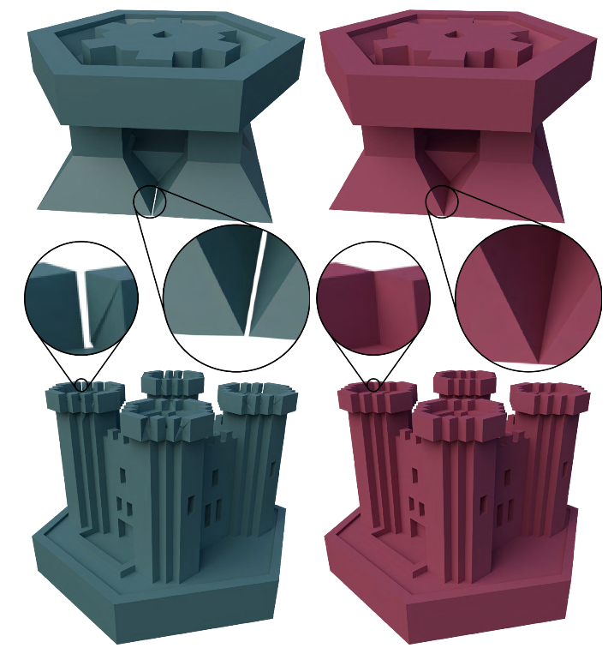
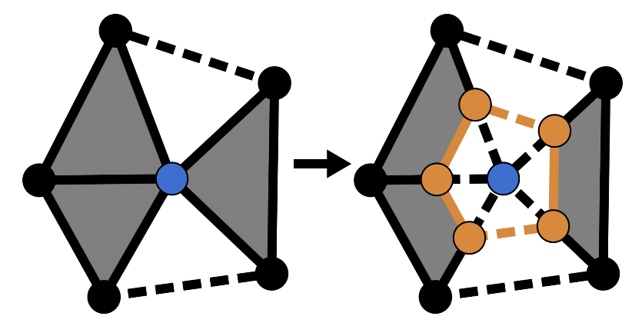
Ok – But Why?
Separating objects
Adding a thin layer of material around an object
Inserting volumes represented as surfaces or polylines
Make non-manifold meshes manifold

Slide 4


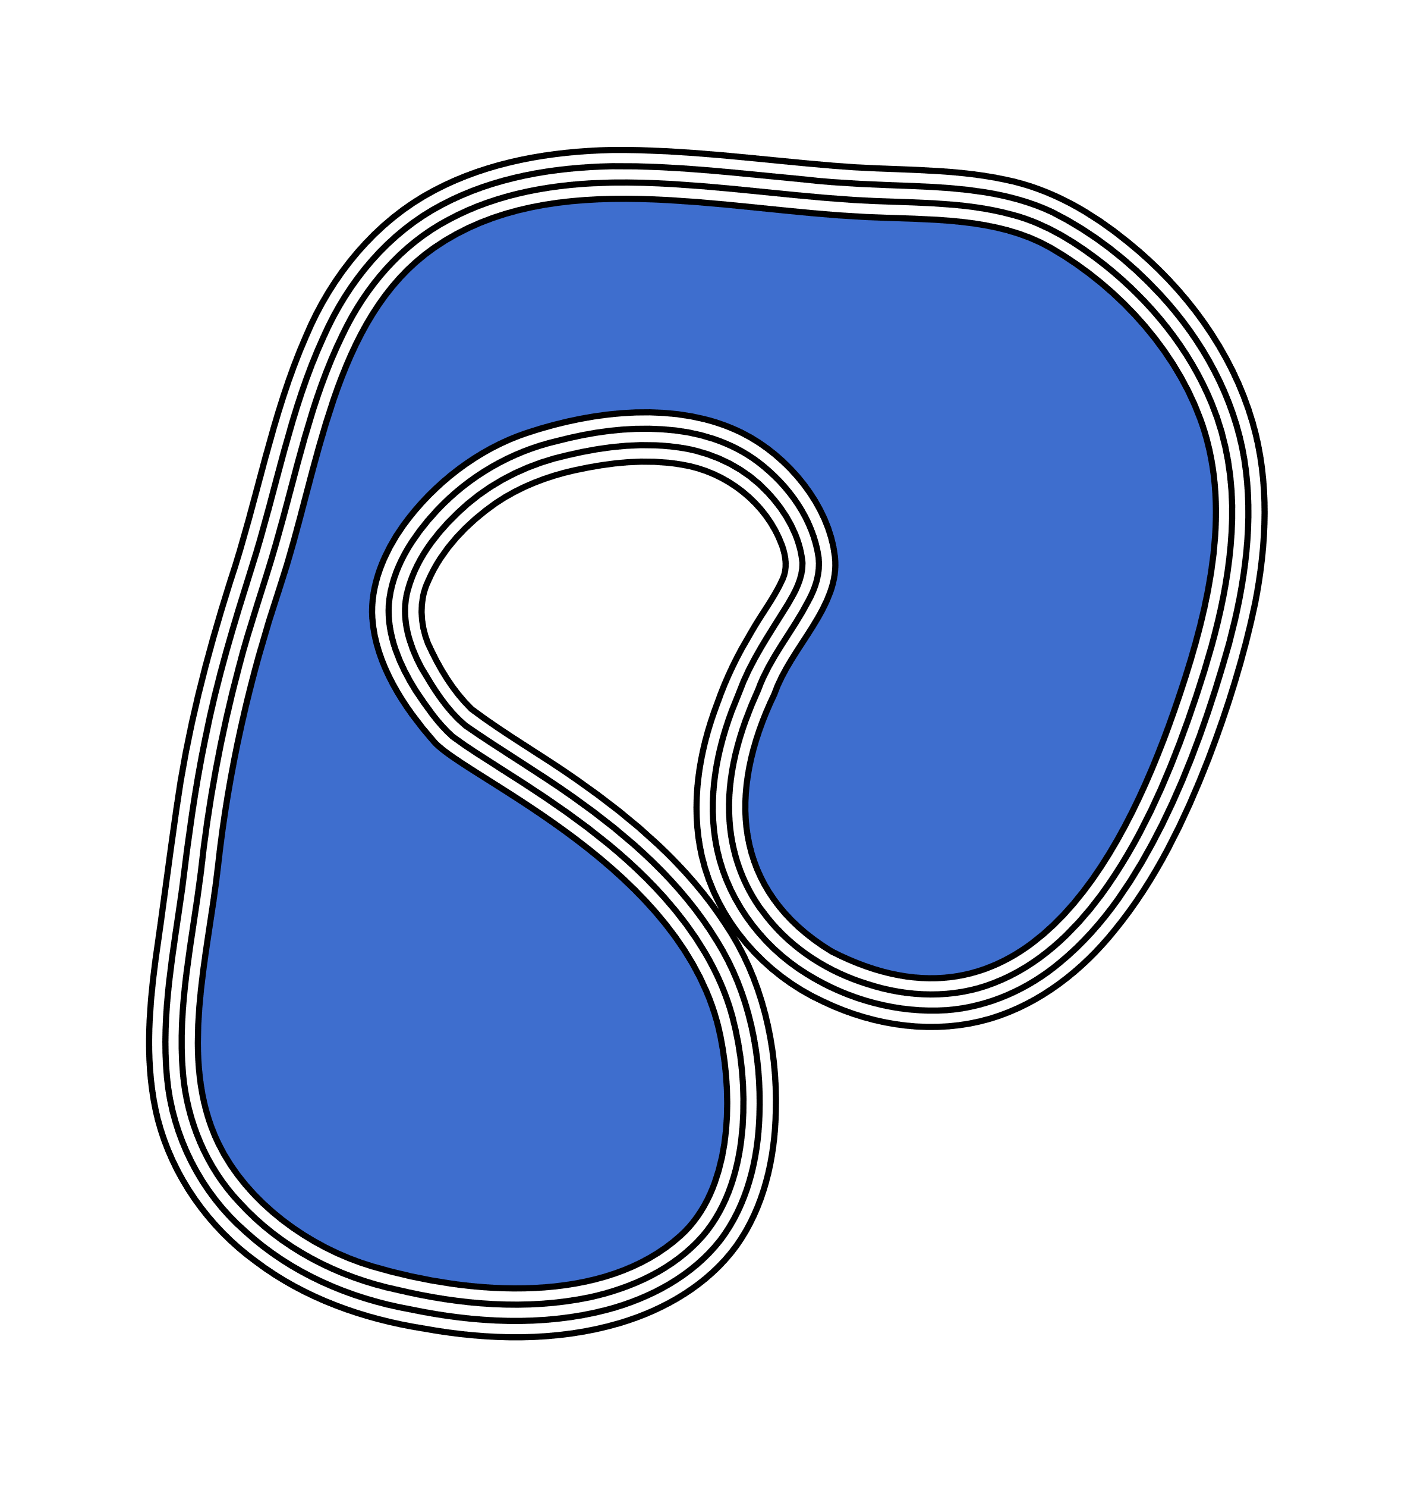
Topological Offsets
infinitesimal offsets
Notes:
I mentioned that the topology of our topological offsets is guaranteed, but what is this topology?
All offsets with a distance very close to 0 up to a certain threshold have the same topology. We call those the infinitesimal offsets.
Only if you went beyond that threshold would the topology change.

Slide 5
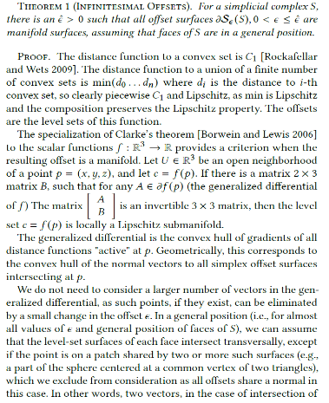
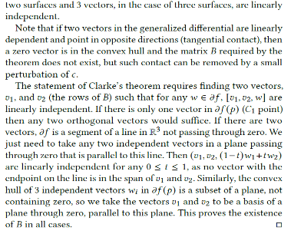
Topological Offsets
manifold
infinitesimal offsets
Notes:
I mentioned that the topology of our topological offsets is guaranteed, but what is this topology?
All offsets with a distance very close to 0 up to a certain threshold have the same topology. We call those the infinitesimal offsets.
Only if you went beyond that threshold would the topology change.

Slide 6
Topological Offsets
topological offset
same topology
infinitesimal offsets
Notes:
Our topological offsets are guaranteed to have the same topology as these infinitesimal offsets.

Slide 7
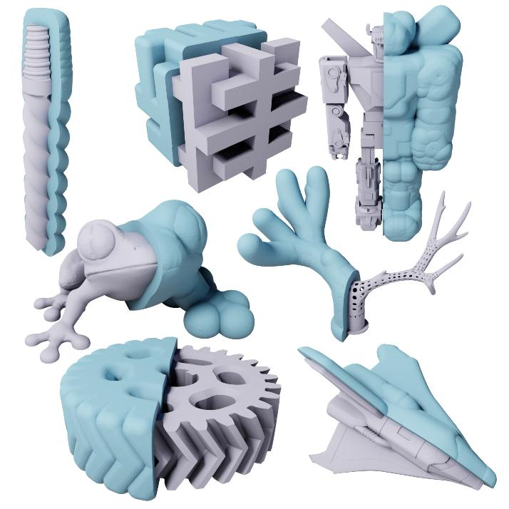
Related Work
Feature-Preserving Offset Mesh Generation from Topology-Adapted Octrees. Zint et al. (2023).
Feature-preserving
Tested on Thingi10k
Self-intersections
Notes:
Let me quickly introduce two related methods.
The first one is actually my own work.
Here, we managed to construct offsets with sharp features and good mesh quality.
The method was tested on Thingi10k and proved to be very robust.
However, we had a few cases with self-intersections in our output, and that bothered me quite a bit back then.

Slide 8
Related Work
Topological guarantees
Input must be a closed manifold surface
Output is a cage not an offset
Robust Coarse Cage Construction With Small Approximation Errors. Guo et al. (2024).
Notes:
The second method I want to mention is for constructing cages.
It comes with topological guarantees that are similar to our own.
However, the input must be a closed and manifold surface, and the output is a cage and not an offset.
So, while it is definitely related, the outputs of the two methods are not really comparable.

Slide 9
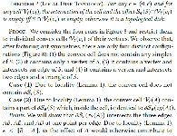
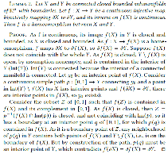
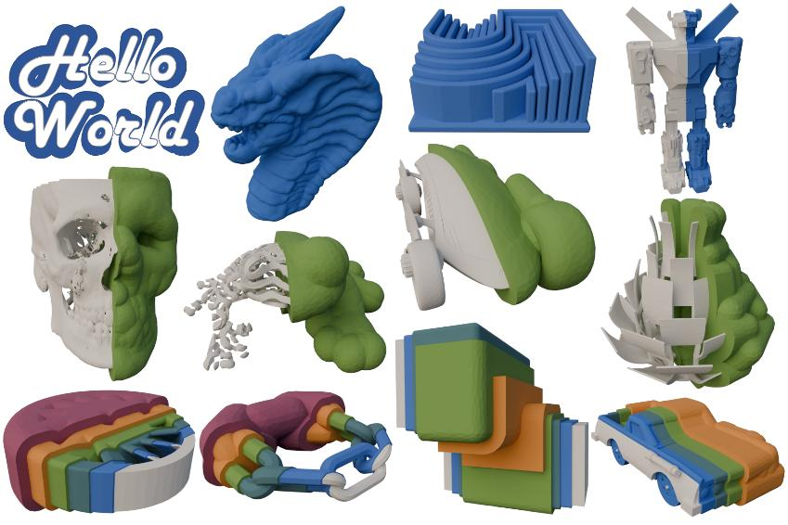
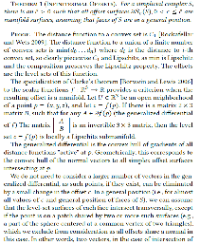
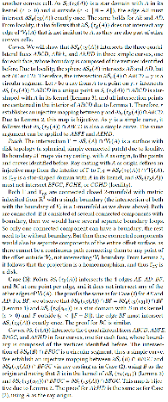
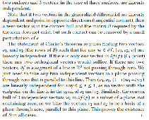
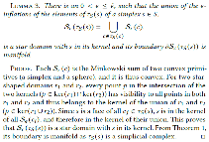
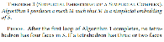
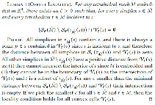
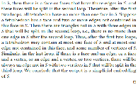
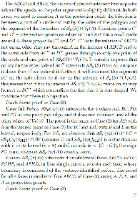
Topological Offsets
PROOFS
No self-intersections
No intersections with the input
Topology of an infinitesimal offset
GUARANTEES
Notes:
Back to our topological offsets.
We know that they don’t have any self-intersections, no intersections with the input, and that they have the topology of an infinitesimal offset.
And these things were not just shown experimentally, but they are guaranteed with actual proofs.
As you can see, some of them are quite lengthy, so I invite you all to look them up in the paper because they were a lot of work. We spent several weeks on them, and it would be nice if some of you would read them.

Slide 10
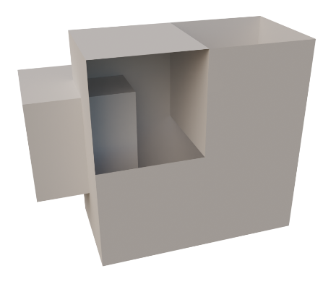
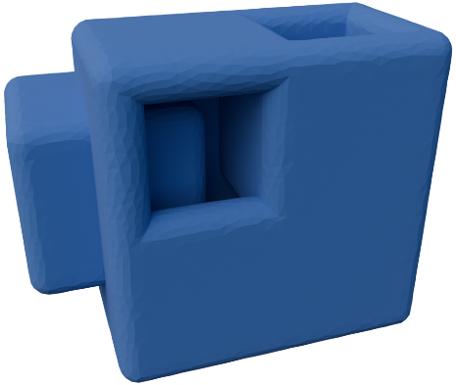
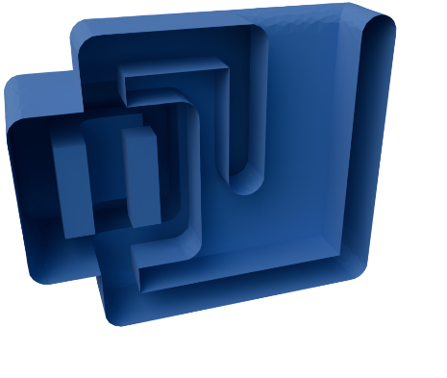
Topological Offsets
Input can be any simplicial complex
Notes:
The input to our method can be any simplicial complex.
So, the input can have open boundaries, and also non-manifold edges and vertices.
Our proofs even support dangling edges and point clouds.

Slide 11
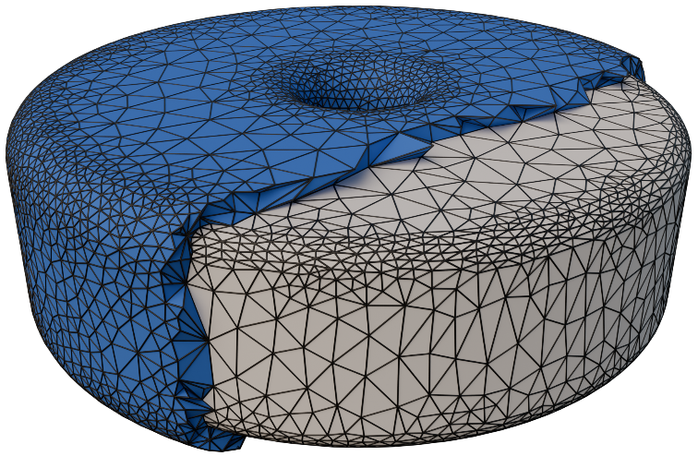
Topological Offsets
Input can be any simplicial complex
Output is a tetrahedral mesh
Notes:
The output of our method is a volumetric mesh with the input and the offset embedded into it.
So, you don’t just get an offset surface but a discretization of the entire volume.

Slide 12
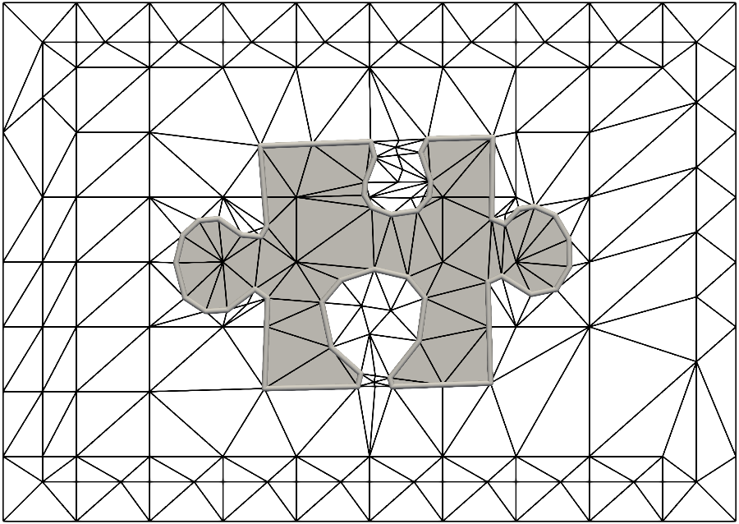
Pipeline
Embed input in volumetric mesh
Mesh must be a simplicial embedding of the input
Any volumetric mesh can be converted into a simplicial embedding
simplicial embedding
Notes:
OK, how does this work?
The first thing we need to do is embed the input in a volumetric mesh. In 2D, you can triangulate the domain. In 3D, there are methods like Tetwild or Constrained Delaunay Tetrahedralization.
Our volumetric mesh has to fulfill specific criteria, and if it does, we call it a simplicial embedding of the input.
Luckily, any volumetric mesh can be converted into a simplicial embedding with just a few simple operations that I will explain later.

Slide 13
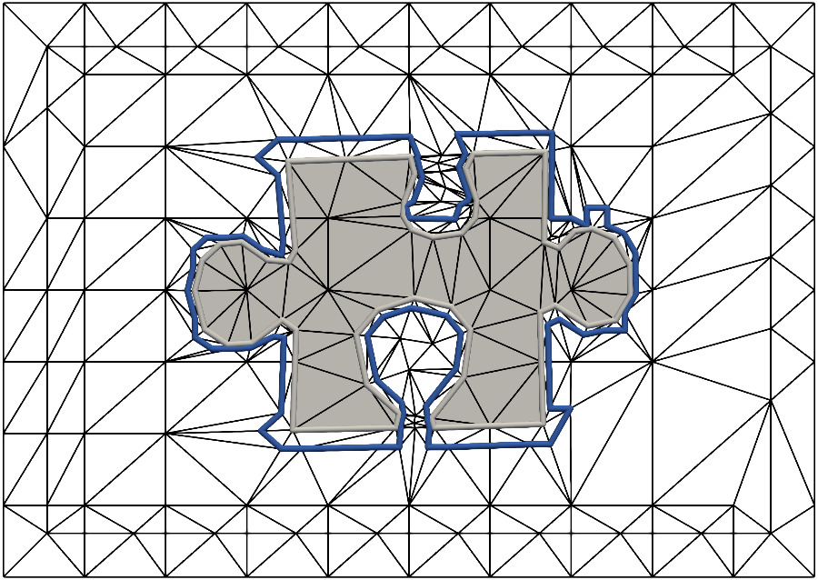
Pipeline
Marching tetrahedra/triangles between input and outside
Infinitesimal offset topology guaranteed
Independently of input geometry
offset initialization
Notes:
When we have our volumetric mesh, we can initialize a topological offset by simply performing Marching Tetrahedra (or Marching Triangles in 2D) between the input vertices and any vertex that is not on the input.
This gives us a surface that is guaranteed to have the topology of an infinitesimal offset. And this, independently of the input geometry. The topology of our offset purely depends on the topology of the input.

Slide 14
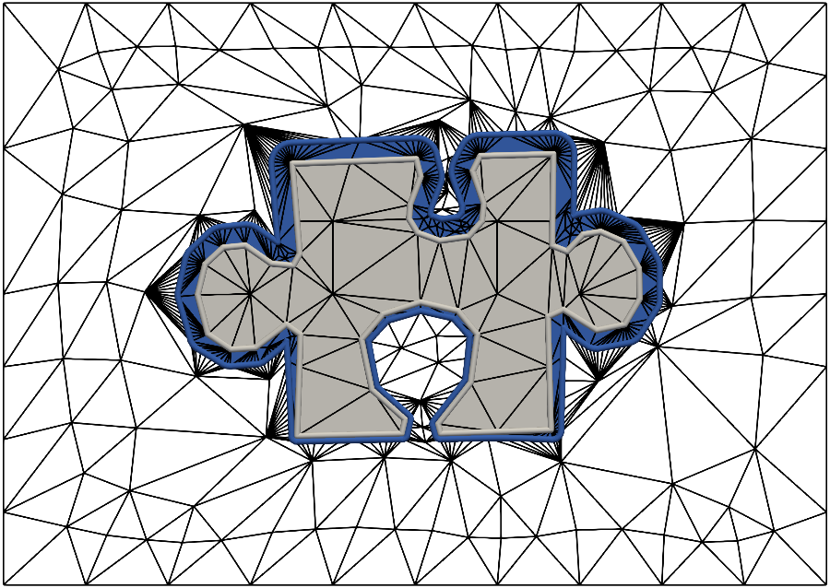
Pipeline
No operations that cause topological changes
No flipped elements → no intersections
Increased runtime due to volumetric mesh
Tested on Thingi10k
55% in < 6 minutes
3% in > 1 hour
simplicial embedding
offset initialization
offset optimization
Notes:
Finally, we can improve the geometry of our offset with some remeshing.
Here, we do not allow any operations that would cause any topological changes to the offset.
Also, we don’t allow for flipped volumetric elements. That way, we can guarantee that there won’t be any intersections of the offset with itself or the input.
Of course, using a volumetric mesh also has some downsides, most importantly an increased runtime in comparison with purely surface-based methods. We tested our method on the Thingi10k dataset and to give you an idea, 55% of the meshes finished within less than 6 minutes but there were 3% that required more than one hour.

Slide 15
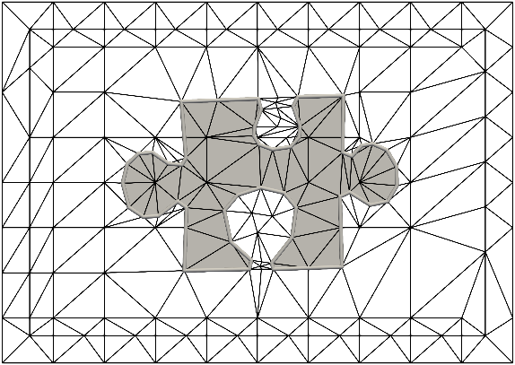
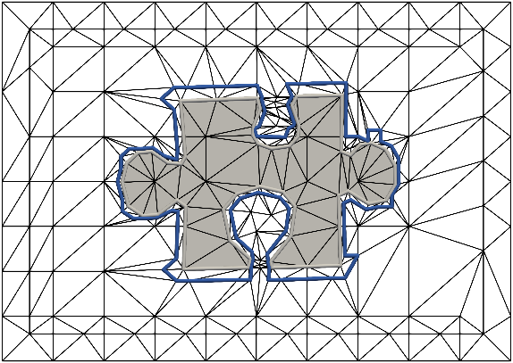
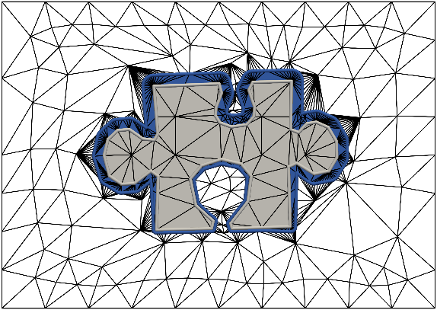
Pipeline
simplicial embedding
offset initialization
offset optimization
Notes:
And with that, our pipeline is complete.
Now, I want to explain to you what the simplicial embedding is and how we can generate it.

Slide 16
Pipeline
simplicial embedding
offset initialization
offset optimization

Slide 17
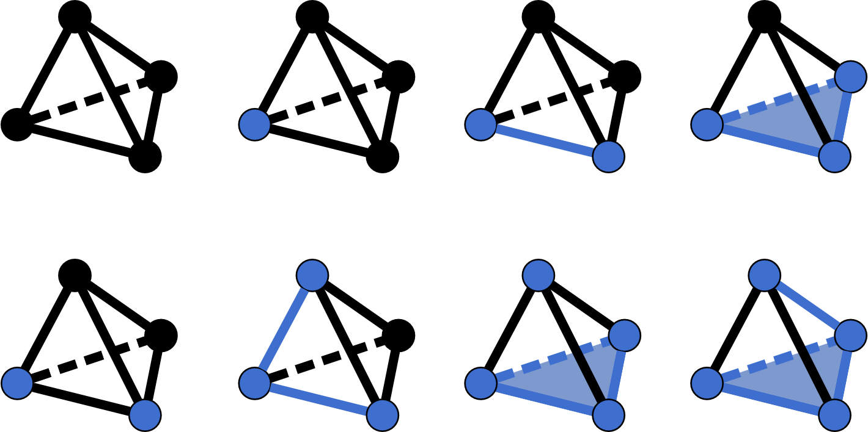

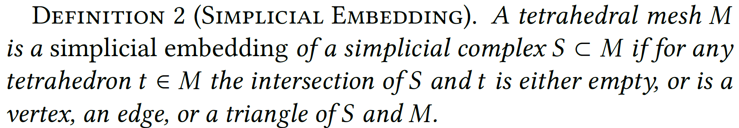
Simplicial Embedding
valid
input
Notes:
In a tet mesh, all tets must be in one of these four configurations to call the mesh a simplicial embedding.
The input is marked in blue.
Every tet must either not contain any input, one input vertex, one edge, or one triangle. These are the only configurations that are allowed.

Slide 18

Simplicial Embedding
valid
invalid
Notes:
If there is any other configurations, we need to modify the mesh.

Slide 19
Simplicial Embedding
Notes:
This is done with a few splitting operations.

Slide 20
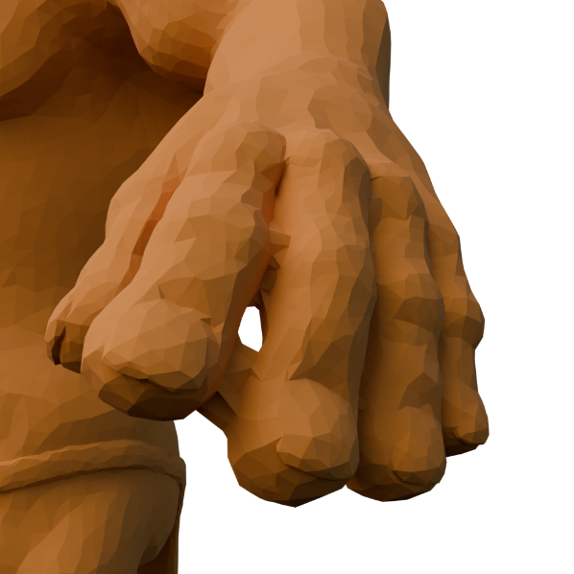
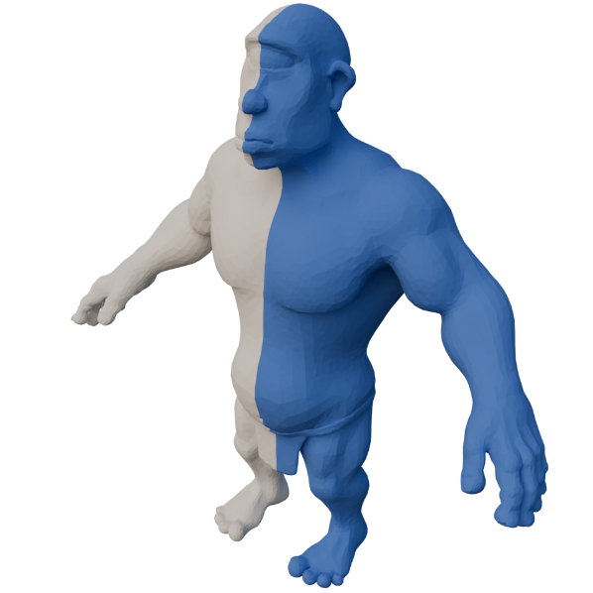
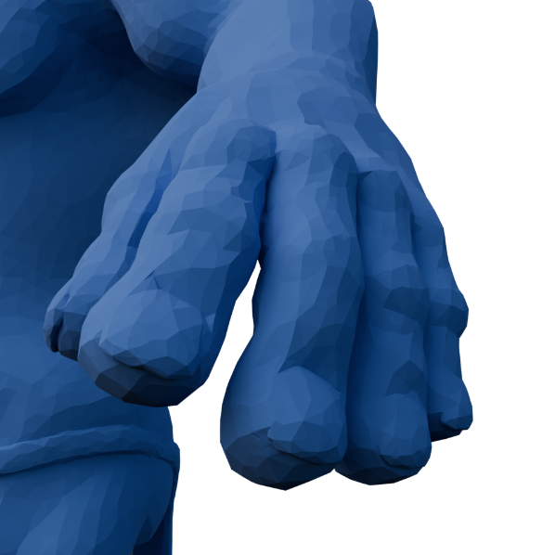
Simplicial Embedding
without simplicial embedding
with simplicial embedding

Slide 21
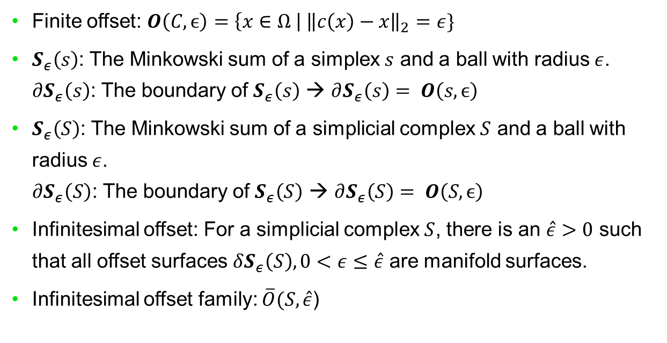
Simplicial Embedding – Proof (Simplified)
Finite offset: $O\left(C,ϵ\right)=\left\{x∈Ω \right| {\left\|c\left(x\right)−x\right\|}_{2}=ε\}$
$S_{ε}\left(s\right)$: The Minkowski sum of a simplex $s$ and a ball with radius $ε$. $∂S_{ε}\left(s\right)$: The boundary of $S_{ε}\left(s\right)$ → $∂S_{ε}\left(s\right)= O\left(s,ϵ\right)$
$S_{ε}\left(S\right)$: The Minkowski sum of a simplicial complex $S$ and a ball with radius $ε$. $∂S_{ε}\left(S\right)$: The boundary of $S_{ε}\left(S\right)$ → $∂S_{ε}\left(S\right)= O\left(S,ϵ\right)$
Infinitesimal offset: For a simplicial complex $S$, there is an $\hat{ε}>0$ such that all offset surfaces $δS_{ε}\left(S\right), 0<ε≤\hat{ε}$ are manifold surfaces.
Infinitesimal offset family: $\overline{O}(S,\hat{ε}$)
infinitesimal offset family

Slide 22
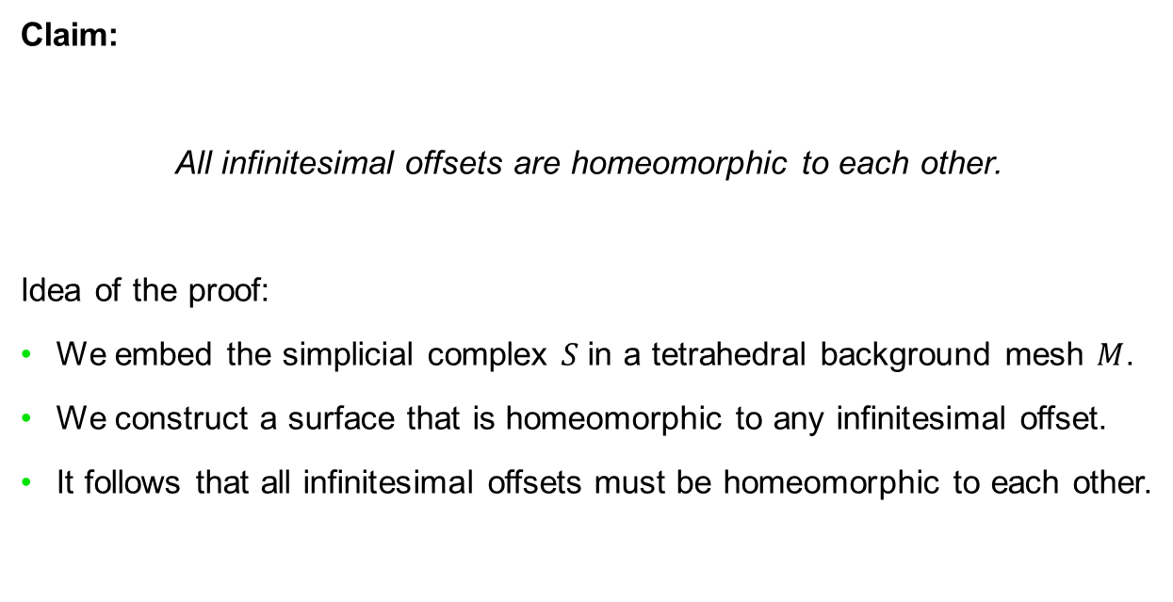
Simplicial Embedding – Proof (Simplified)
Claim:
All infinitesimal offsets are homeomorphic to each other.
Idea of the proof:
We embed the simplicial complex $S$ in a tetrahedral background mesh $M$.
We construct a surface that is homeomorphic to any infinitesimal offset.
It follows that all infinitesimal offsets must be homeomorphic to each other.
infinitesimal offset family

Slide 23
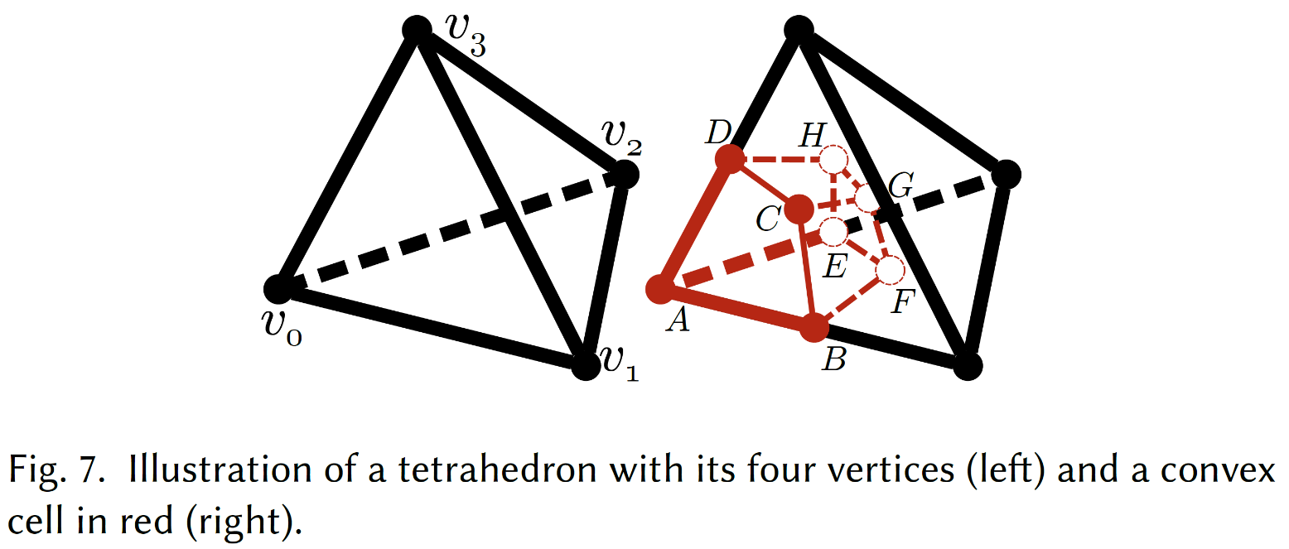
Simplicial Embedding – Proof (Simplified)

Slide 24
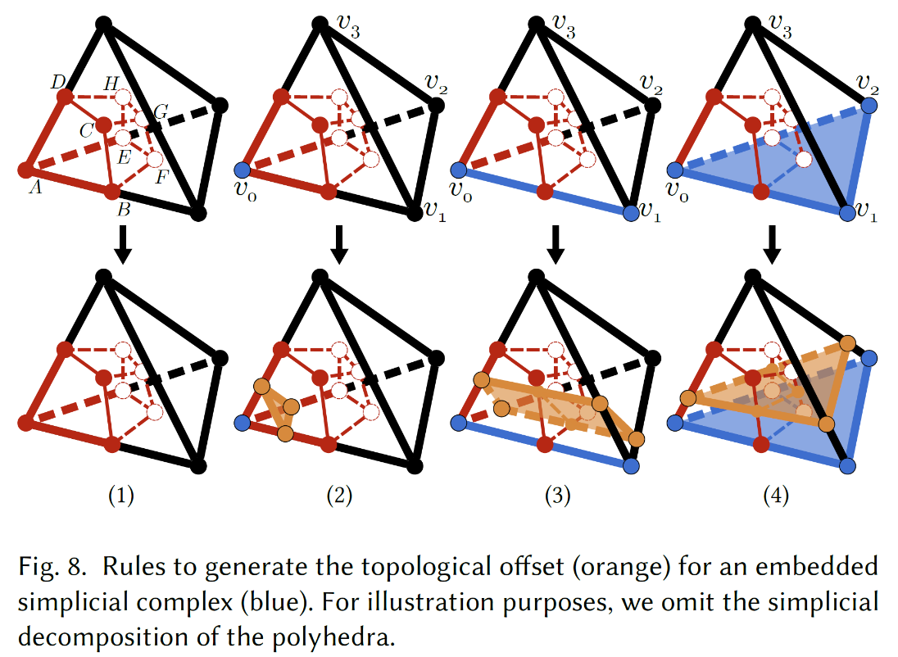
Simplicial Embedding – Proof (Simplified)

Slide 25
Simplicial Embedding
simplicial embedding
offset initialization
offset optimization

Slide 26
Pipeline
simplicial embedding
offset initialization
offset optimization
Notes:
I also want to talk a little bit about the offset optimization

Slide 27
Optimization
simplicial embedding
offset initialization
offset optimization

Slide 28

Local Offset Distance
Notes:
More specifically, about the local offset distance.
To avoid offsets from pushing against each other, we adapt the offset distance locally.

Slide 29


Local Offset Distance
Notes:
To avoid offsets from pushing against each other, we adapt the offset distance locally.
We provide a heuristic so that the user only needs to specify a global target distance, and we then automatically adapt the distance where necessary.

Slide 30
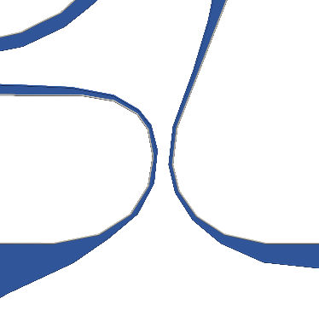
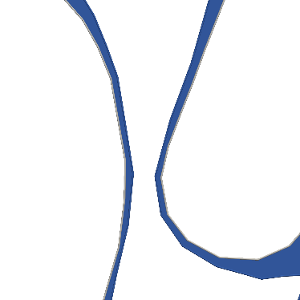
Local Offset Distance
Notes:
To avoid offsets from pushing against each other, we adapt the offset distance locally.
We provide a heuristic so that the user only needs to specify a global target distance, and we then automatically adapt the distance where necessary.

Slide 31
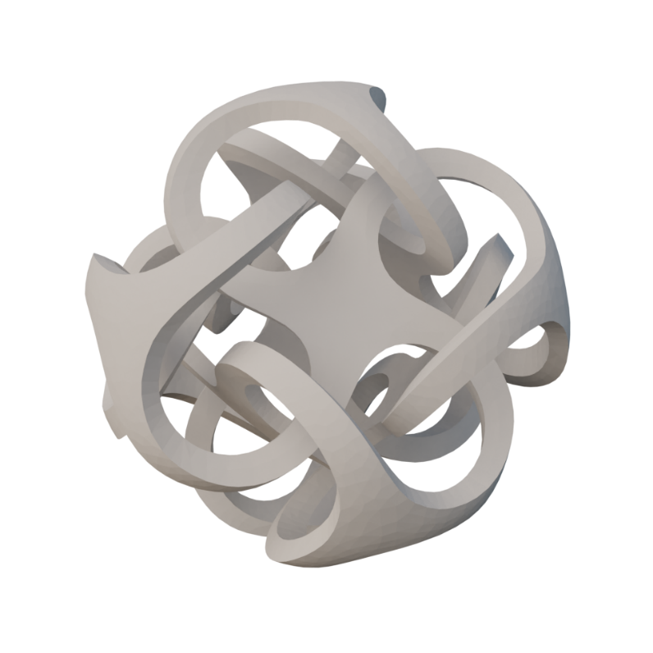
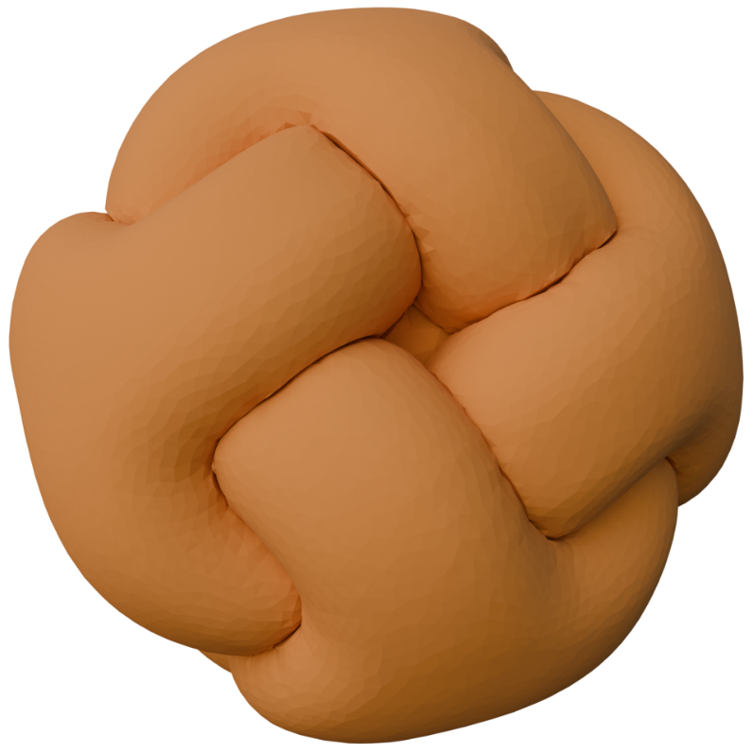
Local Offset Distance
without distance adaptation
Notes:
Here is a 3D example of what it might look like without any distance adaptation

Slide 32
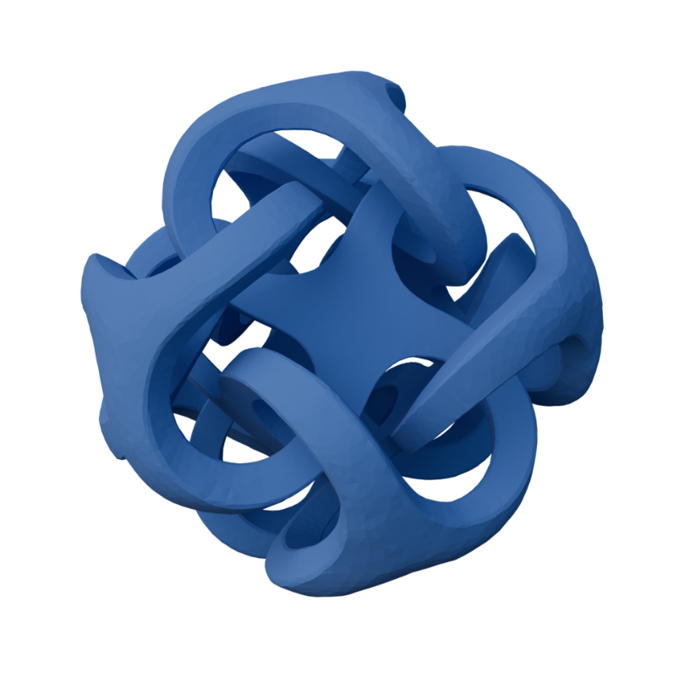
Local Offset Distance
with distance adaptation
Notes:
With distance adaptation, we successfully prevent the offset surfaces from pushing against each other.

Slide 33
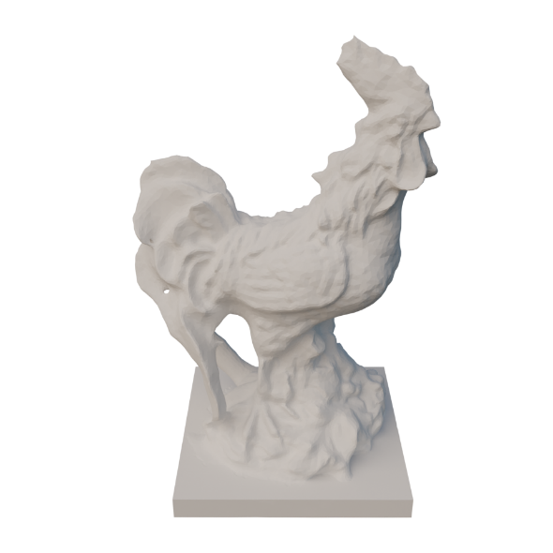
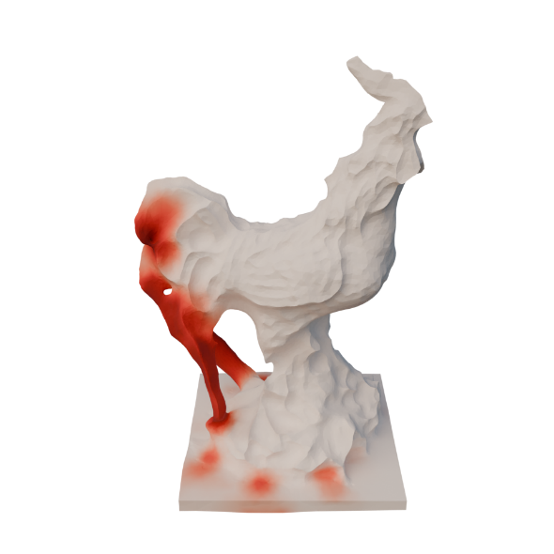
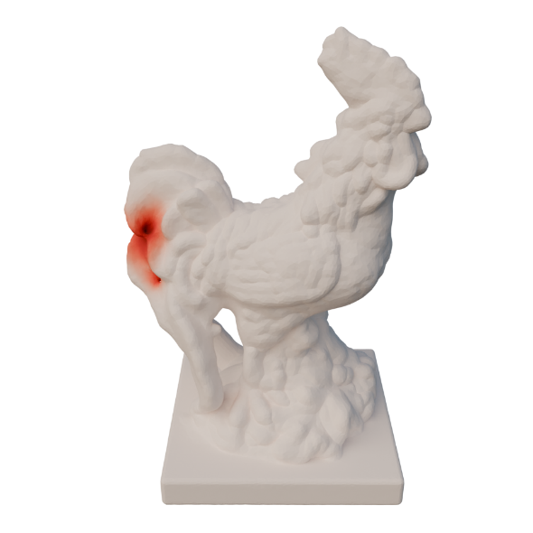
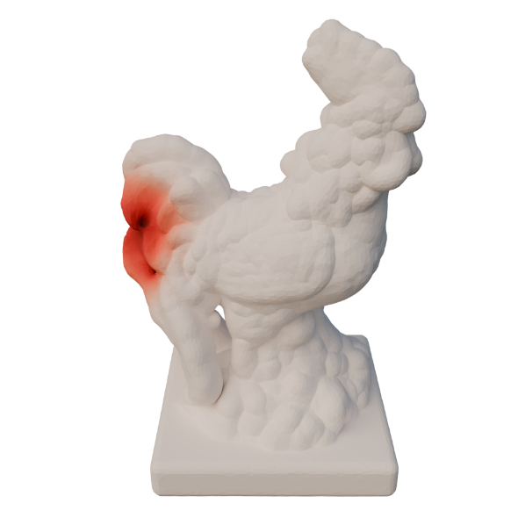
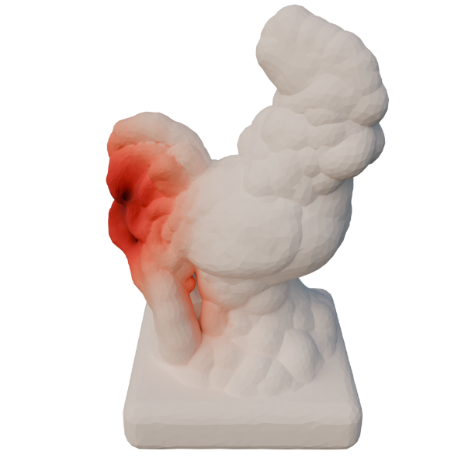
Local Offset Distance
input
-1%
1%
2%
4%
offset distance relative to bbox diagonal
Notes:
This rooster has some tunnels in between the feathers on its tail.
As you can see, the distance is just locally adapted in that region. Other areas, like the head, can reach the target distance without any issues.

Slide 34
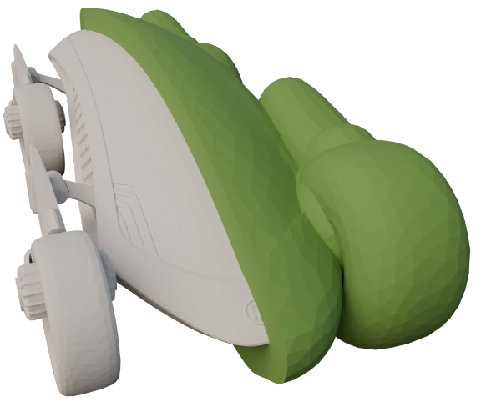
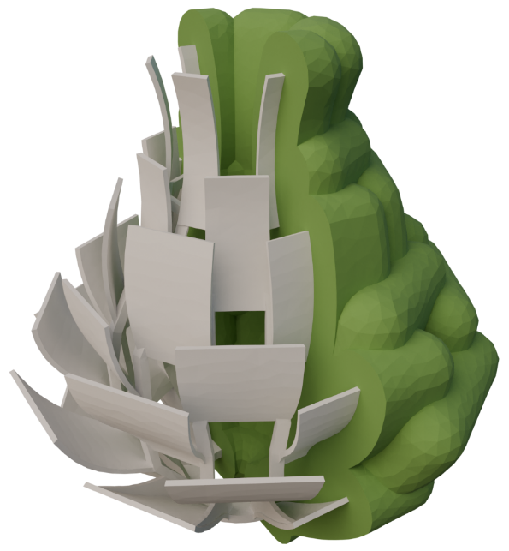




Finite Offsets
Self-intersection-free
No intersections with the input
Notes:
With just a tiny modification, our method is also capable of generating finite offsets.
These offsets are also self-intersection-free and have no intersections with the input.

Slide 35



Layered Offsets
topological
finite
finite
Topological or finite offsets
No intersections in between layers
Tetrahedral mesh
Notes:
Finally, we can also generate multiple offset layers.
This works for topological and finite offsets.
It is guaranteed that the offset layers do not intersect each other.
And the output of our method is a tetrahedral mesh that contains all the offset layers.

Slide 36

Thank You
https://github.com/wildmeshing/topological-offsets
Notes:
And with that I conclude my talk. I hope to see some of you later at the poster. Thank you!

Slide 37



Local Offset Distance

Slide 38

Local Offset Distance

